Slide 1

Algebra 1
Unit 4, Lesson 12 Writing Equations of Parallel and Perpendicular Lines Volume 1, pg. 224

Slide 2


Benchmark
MA.912.AR.2.3
Write a linear two-variable equation for a line that is parallel or perpendicular to a given line and goes through a given point.
volume 1, pg. 224

Slide 3
Integrated Mathematical Thinking and Reasoning Standards
MA.K12.MTR.1.1 Actively participate in effortful learning both individually and collectively.
MA.K12.MTR.2.1 Demonstrate understanding by representing problems in multiple ways.
MA.K12.MTR.4.1 Engage in discussions that reflect on the mathematical thinking of self and others.
MA.K12.MTR.5.1 Use patterns and structure to help understand and connect mathematical concepts.
volume 1, pg. 224

Slide 4

Learning Targets
I can write an equation for a line parallel to a given line through a given point.
I can write an equation for a line perpendicular to a given line through a given point.
volume 1, pg. 224

Slide 5

Warm-Up
volume 1, pg. 225

Slide 6
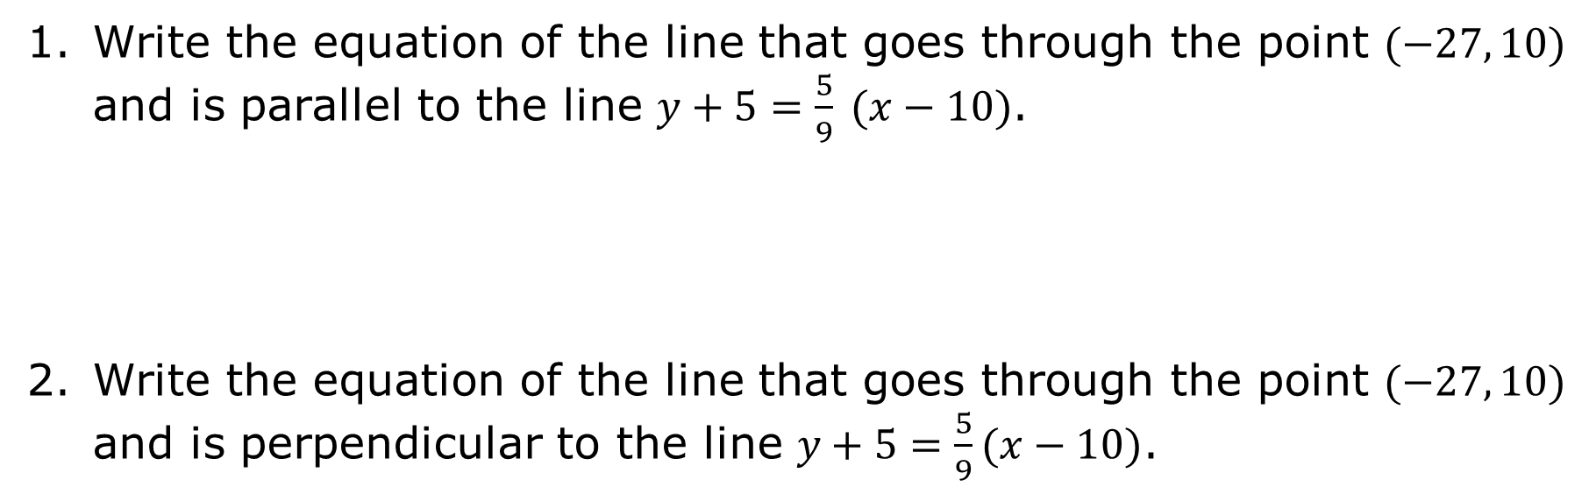
4.12.1 Warm-Up: Bell Work
Write the equation of the line that goes through the point $(−27, 10)$ and is parallel to the line $y+5=\frac{5}{9} (x−10)$.
Write the equation of the line that goes through the point $(−27, 10)$ and is perpendicular to the line $y+5=\frac{5}{9}(x−10)$.
volume 1, pg. 225
Notes:
Video Link: https://algebranation.wistia.com/medias/fi4fidi5y8

Slide 7

Collaboration
volume 1, pg. 225

Slide 8

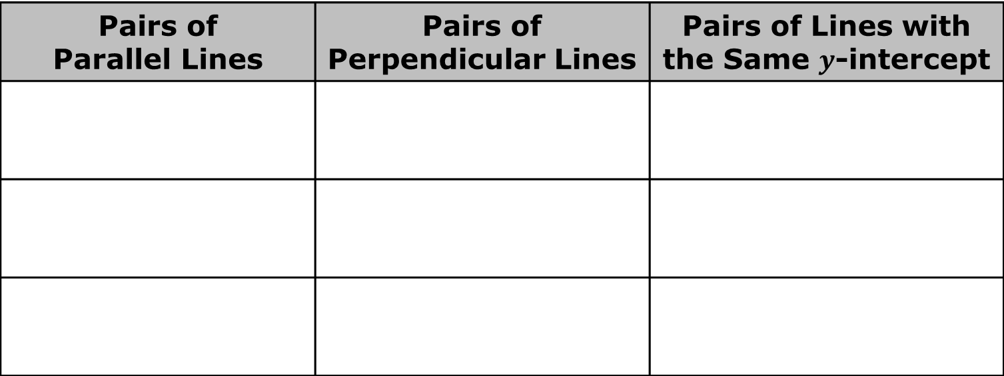
4.12.2 Collaboration: Sorting Equations
Work with your partner to sort the equations into pairs that have the given characteristic. Find three different sets of pairs of equations for each characteristic. Lines may be used more than once.
Pairs of Parallel Lines | Pairs of Perpendicular Lines | Pairs of Lines with the Same $y$-intercept
volume 1, pg. 225

Slide 9
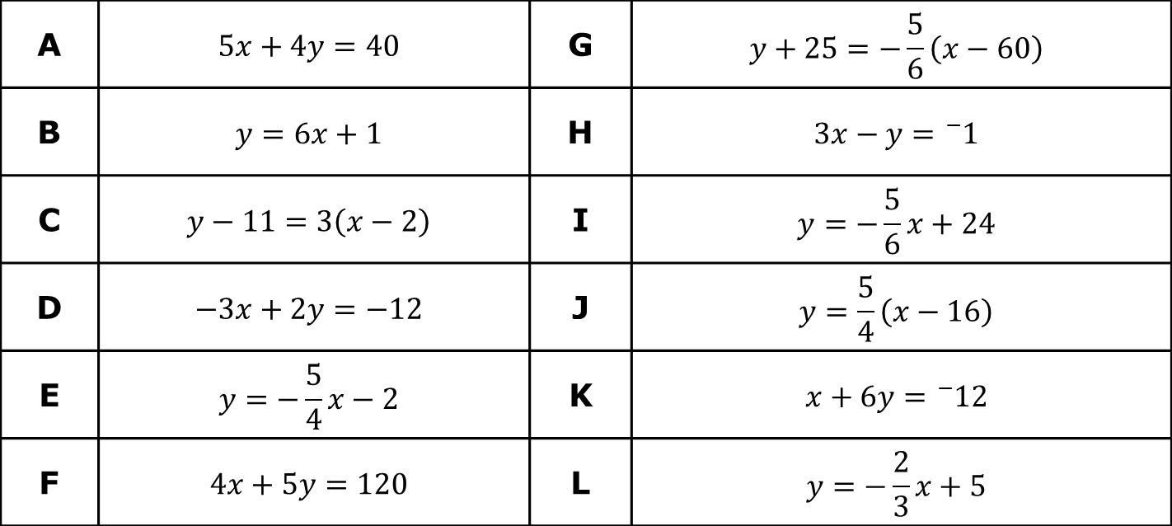
A | $$5x+4y=40$$ | G | $$y+25=−\frac{5}{6}\left(x−60\right)$$
B | $$y=6x+1$$ | H | $$3x−y={}_{}^{−}1$$
C | $$y−11=3\left(x−2\right)$$ | I | $$y=−\frac{5}{6}x+24$$
D | $$−3x+2y=−12$$ | J | $$y=\frac{5}{4}\left(x−16\right)$$
E | $$y=−\frac{5}{4}x−2$$ | K | $$x+6y={}_{}^{−}{12}$$
F | $$4x+5y=120$$ | L | $$y=−\frac{2}{3}x+5$$
volume 1, pg. 225

Slide 10
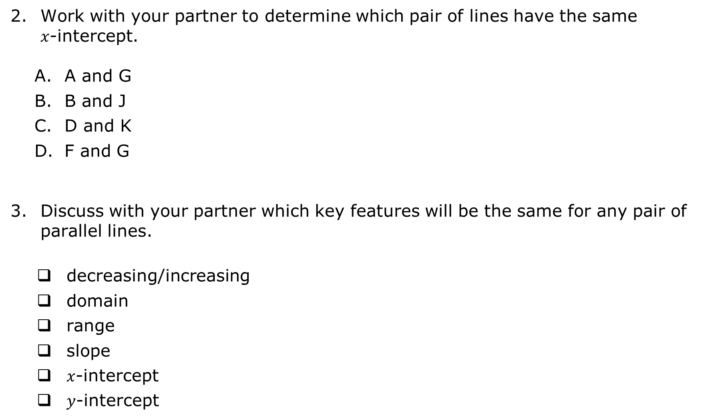
Work with your partner to determine which pair of lines have the same $x$-intercept.
A and G
B and J
D and K
F and G
Discuss with your partner which key features will be the same for any pair of parallel lines.
decreasing/increasing
domain
range
slope
$x$-intercept
$y$-intercept
volume 1, pg. 226

Slide 11
Discuss with your partner which key features will be the same for any pair of perpendicular lines.
decreasing/increasing
domain
range
slope
𝑥-intercept
𝑦-intercept
volume 1, pg. 226

Slide 12

Your Turn
volume 1, pg. 226

Slide 13

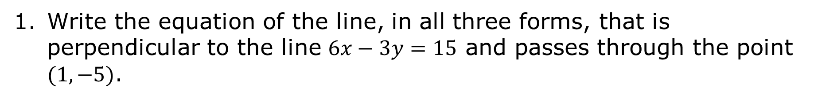
4.12.3 Your Turn!
Write the equation of the line, in all three forms, that is perpendicular to the line $6x−3y=15$ and passes through the point $(1, −5)$.
Point-Slope Form | Slope-Intercept Form | Standard Form
volume 1, pg. 226

Slide 14
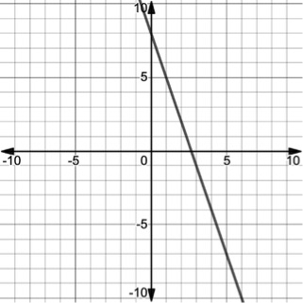
Write the equation of the line, in all three forms, that is parallel to the line shown on the coordinate grid and that passes through the point $(−4, −7)$.
volume 1, pg. 227

Slide 15
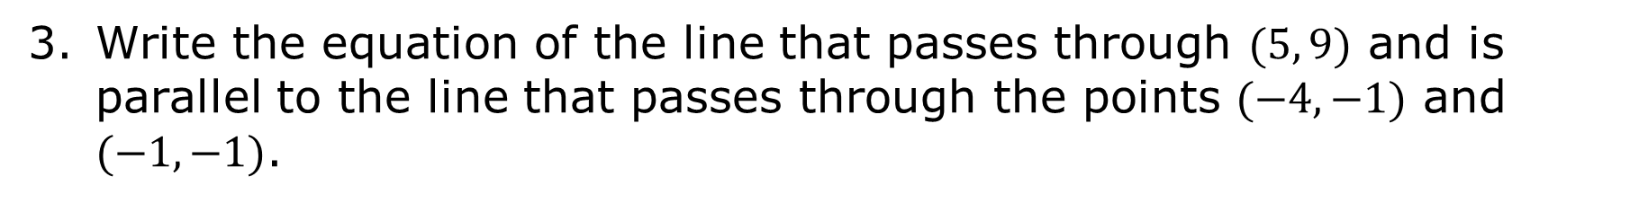
Point-Slope Form | Slope-Intercept Form | Standard Form
Write the equation of the line that passes through $(5, 9)$ and is parallel to the line that passes through the points $(−4, −1)$ and $(−1, −1)$.
volume 1, pg. 227

Slide 16
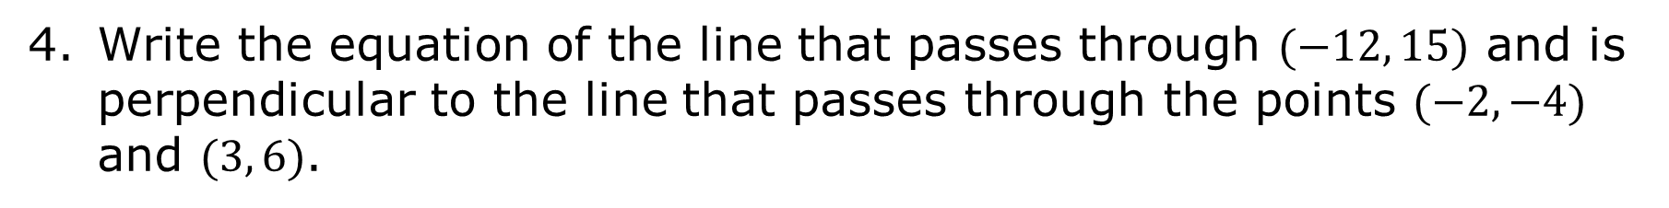
Write the equation of the line that passes through $(−12, 15)$ and is perpendicular to the line that passes through the points $(−2, −4)$ and $(3, 6)$.
volume 1, pg. 227

Slide 17

Wrap-Up
volume 1, pg. 228

Slide 18
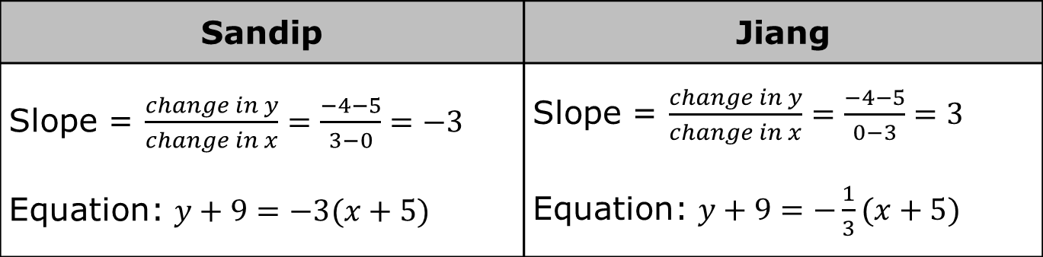
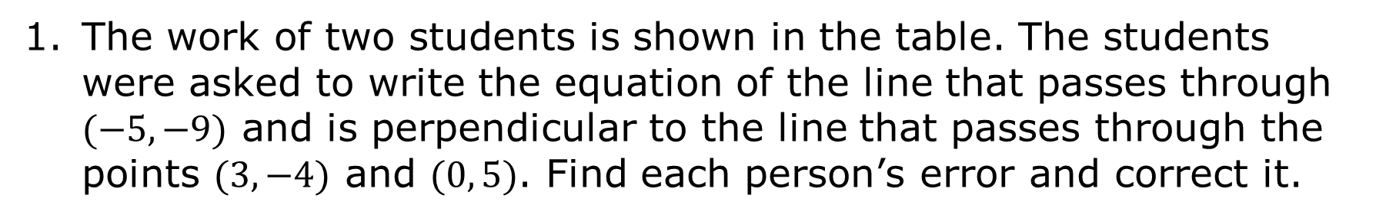
4.12.4 Wrap-Up: Error Analysis
The work of two students is shown in the table. The students were asked to write the equation of the line that passes through $(−5, −9)$ and is perpendicular to the line that passes through the points $(3, −4)$ and $(0, 5)$. Find each person’s error and correct it.
Sandip | Jiang
Slope = $\frac{change in y}{change in x}=\frac{−4−5}{3−0}=−3$ Equation: $y+9=−3(x+5)$ | Slope = $\frac{change in y}{change in x}=\frac{−4−5}{0−3}=3$ Equation: $y+9=−\frac{1}{3}(x+5)$
volume 1, pg. 228

Slide 19
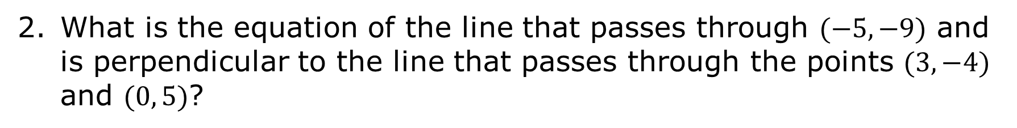
What is the equation of the line that passes through $(−5, −9)$ and is perpendicular to the line that passes through the points $(3, −4)$ and $(0, 5)$?
volume 1, pg. 228

